Slide 1
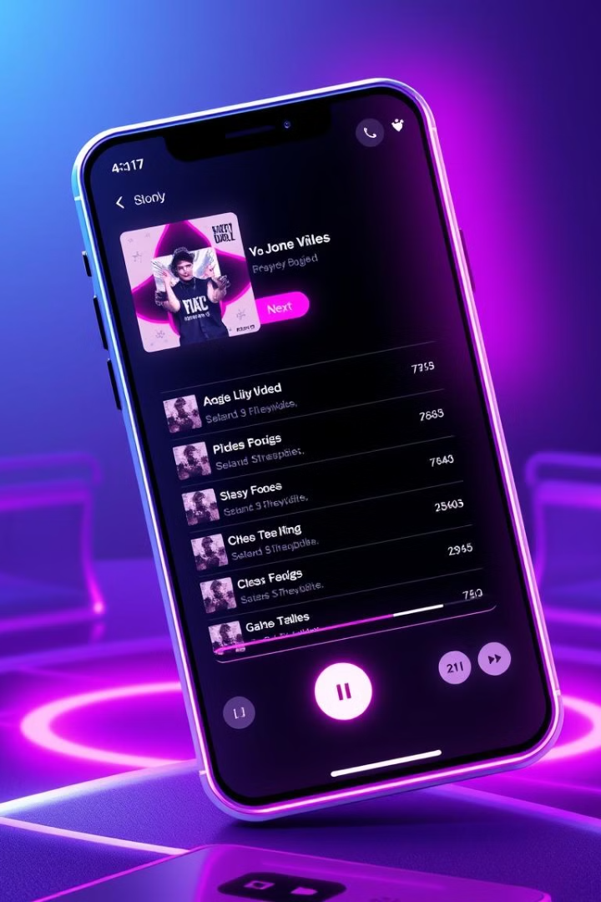
AWS Music Application Architecture
This architecture is designed to host a music player application on AWS, ensuring high availability and scalability.
By Mohamed Fikry
Alaa eldin Mohamed
Randa Saad
Amgad Mohamed

Slide 2
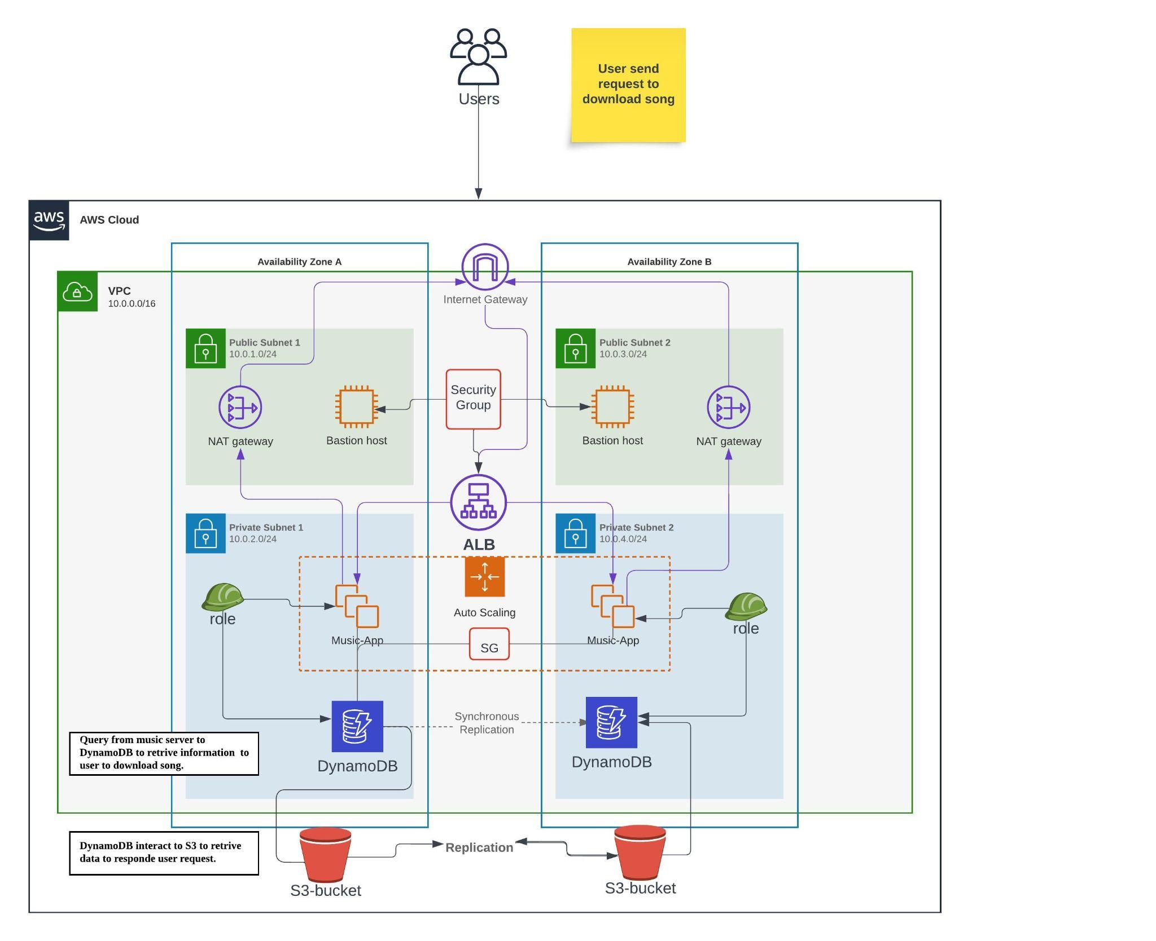
Project Diagram
Project Component
VPC
Subnet
Nat Gateway
Internet Gateway
IAM
Security Groups
EC2
Autoscaling
Load Balancer
S3
DynamoDB
security Key

Slide 3
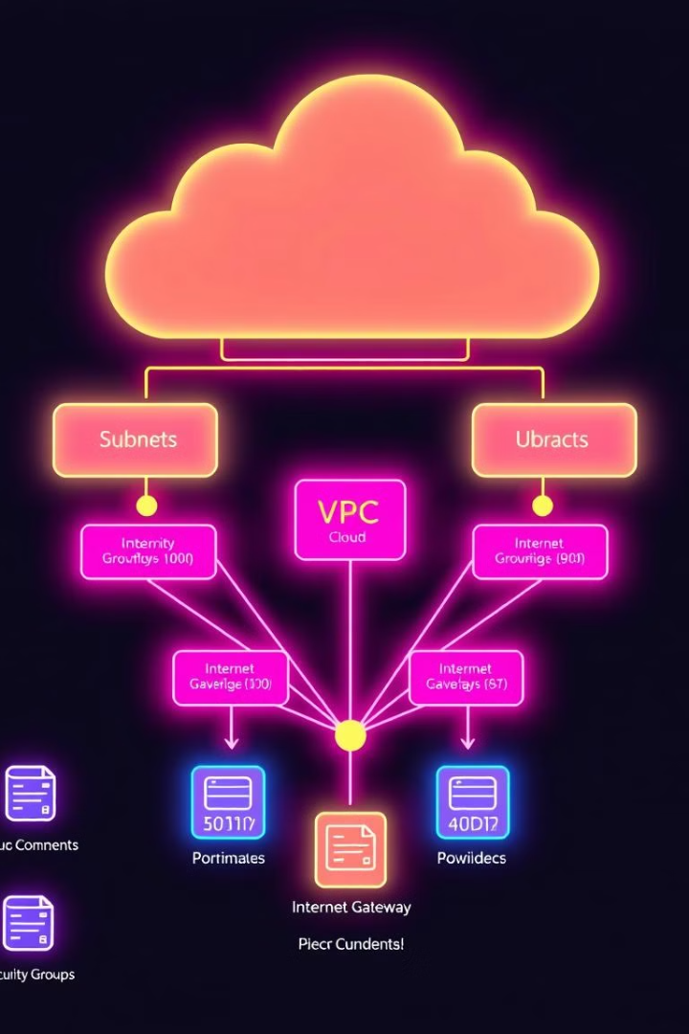
VPC (Virtual Private Cloud)
The application is deployed inside a VPC, ensuring network isolation and secure management of resources.
Network Isolation
The VPC provides a secure and isolated environment for the application, separating it from the public internet and other AWS resources.
Resource Management
The VPC allows for granular control over network access, security groups, and routing rules, enabling secure and efficient management of resources.

Slide 4
VPC (CLDR BLOCK)
VPC CIDR Block: In our architecture, we have created a VPC with the IP address range 10.0.0.0/16. This provides up to 65,536 IP addresses for resources in your AWS environment

Slide 5
VPC (SUBNETS)
Subnets are smaller sections of your VPC that allow you to segregate and organize resources for better management, security, and performance.
You’ve created two subnets in each Availability Zone (AZ):
Public Subnets in AZ-A (10.0.1.0/24) and AZ-B (10.0.3.0/24)
Private Subnets in AZ-A (10.0.2.0/24) and AZ-B (10.0.4.0/24)

Slide 6
VPC (PUBLIC SUBNET)
Public Subnets:
These subnets are exposed to the internet and house components that need to interact with the public. For example:
NAT Gateway – Allows private subnet resources to connect to the internet without exposing them.
Bastion Host – Provides secure SSH access to private instances

Slide 7
VPC (PRIVATE SUBNET)
These subnets contain resources that should not be directly accessible from the internet (e.g., EC2 instances running your music app and DynamoDB).
Only resources in the public subnets (like the NAT Gateway and Load Balancer) can communicate with the internet.
These subnets contain resources that should not be directly accessible from the internet (e.g., EC2 instances running your music app and DynamoDB).
Only resources in the public subnets (like the NAT Gateway and Load Balancer) can communicate with the internet.

Slide 8
VPC (ROUTE TABLE)
Route tables define the rules that control how network traffic flows within your VPC. Each subnet is associated with a route table that determines where network traffic is directed.
Public Subnets' Route Table:
The route table for your public subnets directs internet-bound traffic to the Internet Gateway.
Destination: 0.0.0.0/0
Target: Internet Gateway (IGW)
This allows resources like the Bastion Host and NAT Gateway to send and receive traffic from the internet.
Private Subnets' Route Table:
The private subnets do not have direct access to the internet. Instead, they route external requests through the NAT Gateway:
Destination: 0.0.0.0/0
Target: NAT Gateway (to allow EC2 instances in the private subnets to access the internet for software updates)

Slide 9
VPC (IGW & NAT GATEWAY)
The Internet Gateway connects your VPC to the public internet, enabling internet communication for resources in the public subnets.
Resources with public IP addresses can send and receive data to and from the internet using the IGW.
NAT Gateway (Network Address Translation Gateway):
The NAT Gateway allows resources in the private subnets to access the internet for updates and downloads without exposing them to incoming traffic.
Example: Your application servers in the private subnets use the NAT Gateway to reach external services like AWS updates or to interact with APIs.

Slide 10
VPC (SECURITY GROUP)
Security Groups are stateful firewalls that control inbound and outbound traffic for your AWS resources. In your architecture:
The Bastion Host’s SG only allows inbound SSH access from specific IP addresses (administrators) and restricts outbound traffic.
The EC2 instances’ SG only allows traffic from the Load Balancer, ensuring the music app is protected from unwanted traffic.
The DynamoDB SG restricts access to only the application servers within the private subnets.

Slide 11
VPC (BEST PRACTICES)
Security: The combination of private subnets, NAT Gateway, Bastion Host, and Security Groups ensures that critical resources (like EC2 instances and databases) are protected from the internet and are only accessible through controlled channels.
High Availability: The use of multiple availability zones and redundancy across AZ-A and AZ-B ensures that your application remains available even in the case of an outage in one zone.
Controlled Internet Access: Only the resources that absolutely need it (e.g., Bastion Host, Load Balancer) have direct internet access, while internal resources (e.g., EC2 instances, DynamoDB) rely on the NAT Gateway for controlled outbound traffic.

Slide 12
Application Servers (EC2 Instances)
Hosting the Application:
Our music application is hosted on EC2 instances, which handle everything from processing user requests (e.g., streaming a song or searching for tracks) to managing user sessions, playlists, and interactions with the database (DynamoDB).
These EC2 instances are located in private subnets across multiple availability zones (AZ-A and AZ-B) to ensure high availability and fault tolerance.

Slide 13
Application Servers (EC2 Instances TYPE)
Choosing the Right Instance Type:
For Our AWS Music App, the best practice would be to start with a general-purpose instance like m5.large or t3.medium for handling the bulk of web requests, while ensuring that the instances are capable of processing multiple user requests simultaneously. But in our project we used t2.micro instance type.

Slide 14
Application Servers (EC2 Instances)
Multiple EC2 instances (App Server N, App Server 1, and App Server 2) host the music application. These servers handle user requests, manage music files, and interact with the storage and database layers.
User Requests
Music File Management
Database Interaction
The application servers receive and process user requests, such as playing music, creating playlists, and searching for songs.
The servers manage the storage and retrieval of music files from the S3 bucket, ensuring efficient access and playback.
The servers interact with DynamoDB to store and retrieve user data and song information, ensuring fast and reliable data access.

Slide 15
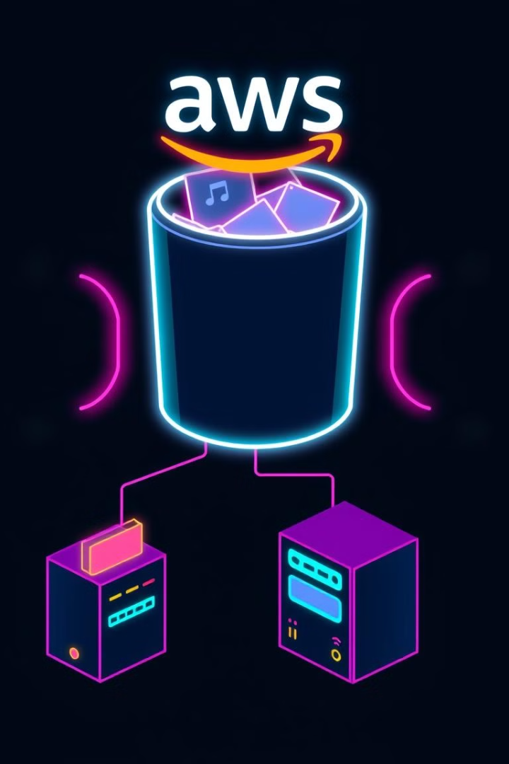
Music Storage (S3 Bucket)
AWS S3 is used to store music files. The application servers store and retrieve the music files from this highly durable and scalable storage service.
1
High Durability
S3 provides a highly durable storage service, ensuring that music files are protected from data loss.
2
Scalability
S3 can scale to accommodate large amounts of music files, ensuring that the application can handle growing music libraries.
3
Cost-Effective
S3 offers a cost-effective storage solution, allowing the application to store music files efficiently.

Slide 16
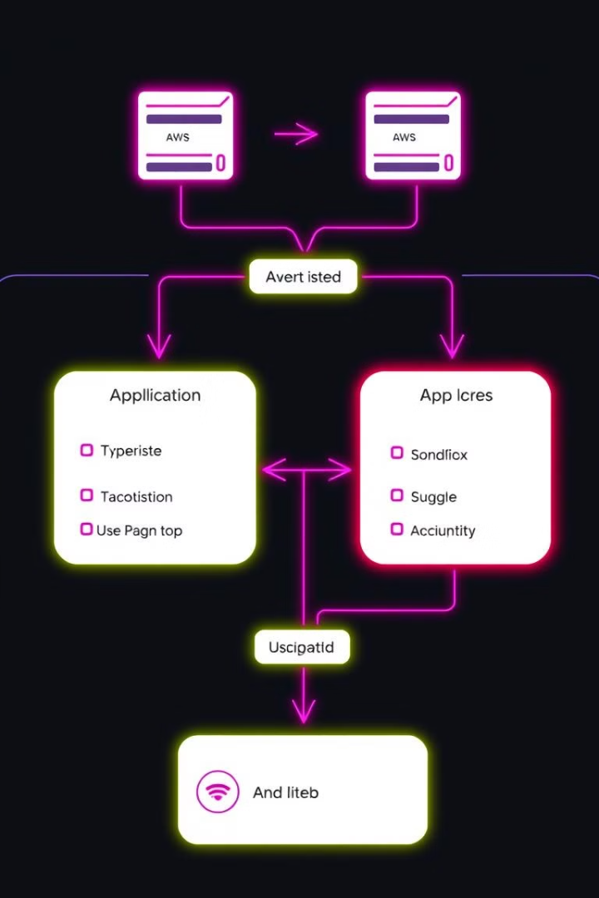
User Data (DynamoDB)
User data and song information are stored in DynamoDB, a fully managed NoSQL database service. It provides fast and predictable performance with seamless scaling.
Feature
Description
Fast Performance
DynamoDB provides low latency and high throughput, ensuring fast and responsive data access.
Predictable Performance
DynamoDB offers consistent performance, regardless of the volume of data or the number of users accessing the database.
Seamless Scaling
DynamoDB automatically scales to accommodate growing data volumes and user traffic, ensuring that the database can handle increasing demands.

Slide 17

Auto Scaling
The application servers are part of an Auto Scaling group, which dynamically adjusts the number of EC2 instances based on the load. This ensures that the application can handle varying traffic while minimizing costs.
1
2
3
Load Monitoring
Instance Scaling
Cost Optimization
The Auto Scaling group monitors the application's load, such as CPU utilization, memory usage, and network traffic.
Based on the load, the Auto Scaling group automatically adds or removes EC2 instances to maintain optimal performance and resource utilization.
By scaling up or down based on demand, the Auto Scaling group helps minimize costs by only using the necessary resources.

Slide 18
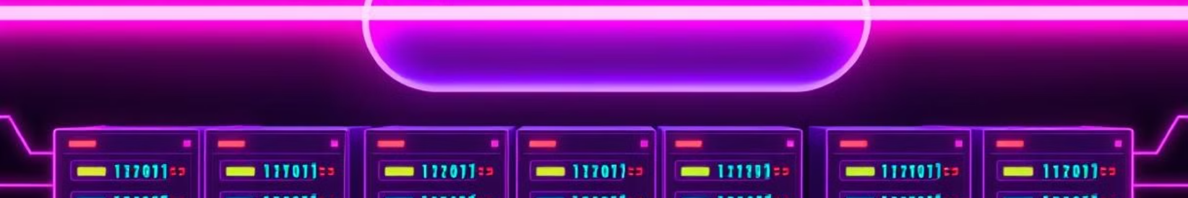



Load Balancer
A load balancer is placed in front of the application servers to distribute incoming traffic evenly across all instances. This enhances the system’s fault tolerance and improves response times.
Traffic Distribution
Fault Tolerance
Improved Response Times
The load balancer distributes incoming traffic across the available application servers, ensuring that no single server is overloaded.
If one application server fails, the load balancer automatically routes traffic to the remaining healthy servers, ensuring continuous service availability.
By distributing traffic evenly, the load balancer reduces the load on individual servers, resulting in faster response times for users.

Slide 19
Services Future Use
Aws Lambda Function
Music File Processing:
Trigger: When a new music file is uploaded to the S3 bucket, it can trigger a Lambda function to process that file (e.g., creating different file formats, compressing the file, generating metadata, or creating thumbnails for album covers).
How It Works:
Each time a user or admin uploads a new song, an event in the S3 bucket triggers Lambda to perform specific processing tasks before making the file available for streaming.
User Activity Logging:
Trigger: When users play a song, Lambda can be triggered via CloudWatch Events or API Gateway (if API calls are involved) to record user activity (e.g., song play count) in DynamoDB or S3.
How It Works:
The user interactions, such as streaming or downloading a song, can generate events that Lambda will use to store logs in DynamoDB. This allows for data analysis later.

Slide 20
Services Future Use
AWS SNS
Use Cases for AWS SNS
Notifications for Music Uploads or User Activities:
Trigger: When new music is uploaded or a significant event occurs (like new user registration, failed EC2 instance, or a music request), Lambda can trigger SNS to send notifications to subscribers.
How It Works: When an S3 upload occurs, Lambda can send a message to an SNS Topic, notifying all subscribers (either users, admins, or other services) about the new file or user activity. For example, users could be notified when new music is available via email or SMS.
Error Handling and System Alerts:
Trigger: When an error occurs in the music app (e.g., failed API requests, EC2 instance failure, S3 permission issues), Lambda or CloudWatch can trigger SNS to notify the system administrators.
How It Works: If a service failure or a system threshold is breached (such as high EC2 load or failure to connect to DynamoDB), CloudWatch alerts Lambda, which then sends a notification through SNS to a predefined list of recipients (admins) via email or SMS.
Subscription-Based Event Notifications:
Trigger: Users can opt-in for custom notifications when their favorite artists upload new music or if a playlist is updated. SNS can send out these custom notifications based on DynamoDB events or S3 uploads.
How It Works: Each time a playlist or song is updated, DynamoDB sends an event to Lambda, which processes the data and publishes a notification to SNS. Users subscribed to this SNS topic will receive a notification.

Slide 21
Video

Slide 22

Questions

